Slide 1
Applications of Electromagnetism: Generators

Slide 2
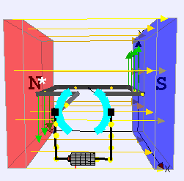
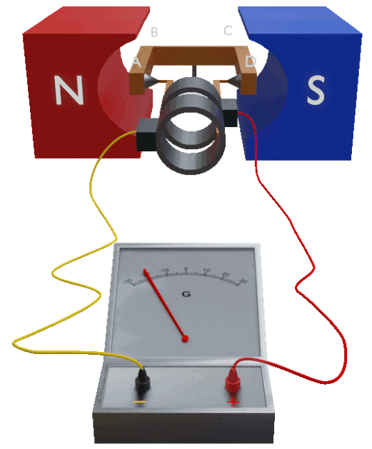
Generators
As you may remember:
Motors convert electrical energy into kinetic energy.
Current is passed through a coil in a magnetic field, causing it to rotate.
A generator is essentially the opposite of a motor:
Generators convert kinetic energy into electrical energy.
An external force rotates a coil in a magnetic field, inducing a current.

Slide 3
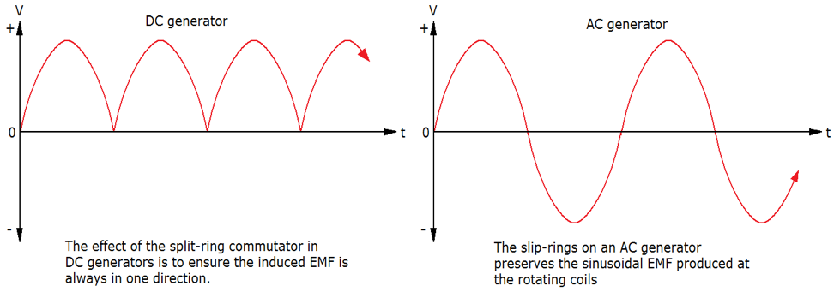
Generator Components
Generators share a number of components with motors:
Permanent magnets to produce a magnetic field
One or more armatures (conductive coils) held in the magnetic field
Brushes which provide low-friction contact between the commutator and the rest of the circuit.
There are two types of generators, each of which has a different type of commutator:
DC generators, which use split ring commutators
AC generators, which use slip ring commutators

Slide 4
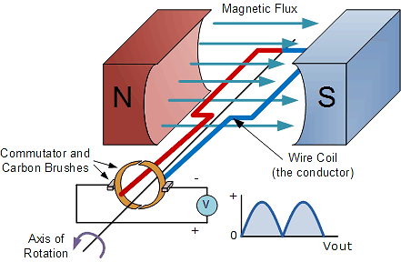
Generator Types: DC
As one side of the armature moves upwards through the magnetic field, a current is induced in it to produce a downwards force (Lenz’s law).
Once that side passes the top and begins to move downwards, a current is induced in it in the opposite direction to produce an upwards force.
The split ring commutators in DC generators are much like the ones in DC motors:
In motors, they change the direction of current to the coil every 180° to maintain a positive torque
In generators, they change the direction of current to the circuit every 180° to maintain a positive voltage

Slide 5
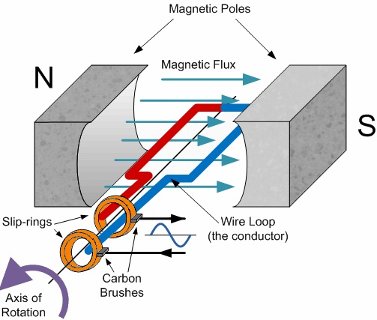
Generator Types: AC
As one side of the armature moves upwards through the magnetic field, a current is induced in it to produce a downwards force (Lenz’s law).
Once that side passes the top and begins to move downwards, a current is induced in it in the opposite direction to produce an upwards force.
The slip ring commutators in AC generators do the opposite: they maintain the same connections between each side of the coil and the circuit, resulting in a current that alternates in direction.

Slide 6
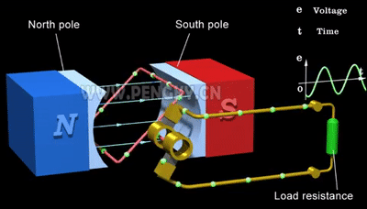

Slide 7
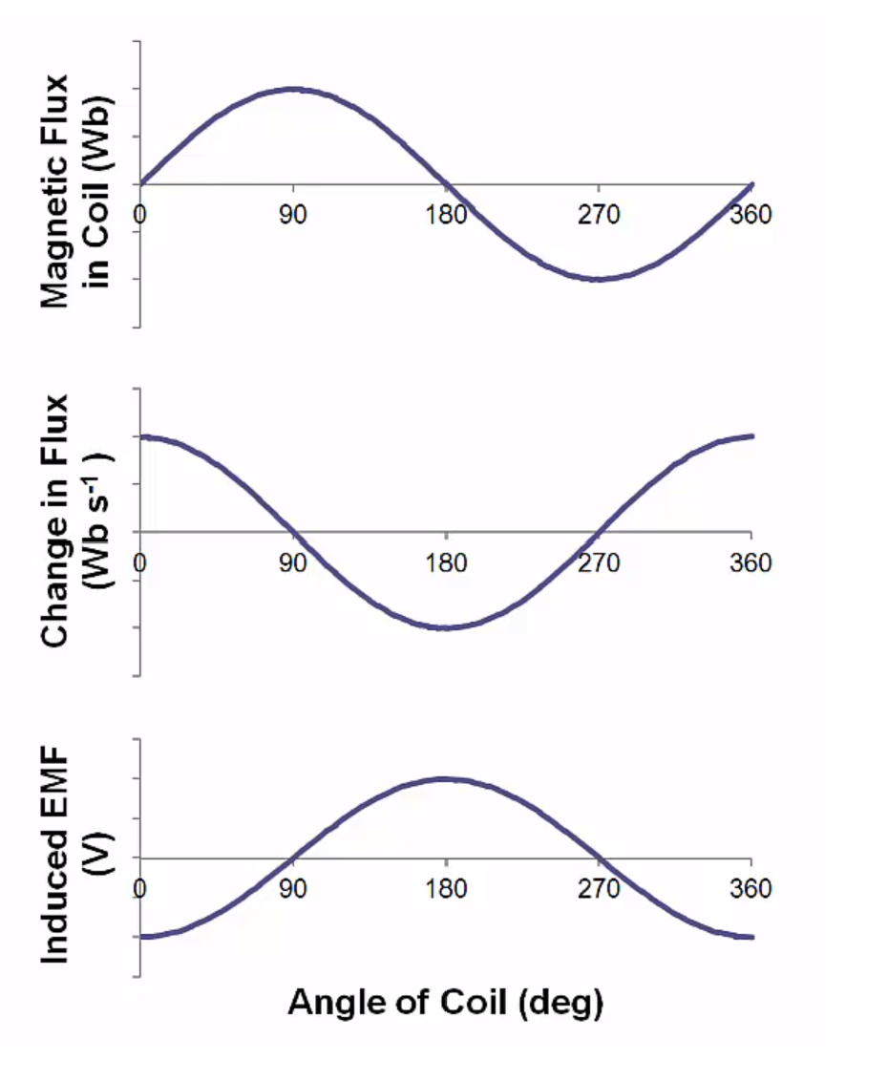
Example #1a
Draw graphs to show each of the following, with the angle between the coil and the magnetic field on the x axis for each one:
The magnetic flux in a coil as it rotates through a magnetic field (where 0° is parallel to the field)
The change in flux within the coil
The induced emf
Notes:
Note that the angle here is between the field and the coil itself, not the normal to the coil as we discussed previously… but the normal does help explain how flux can be negative!

Slide 8
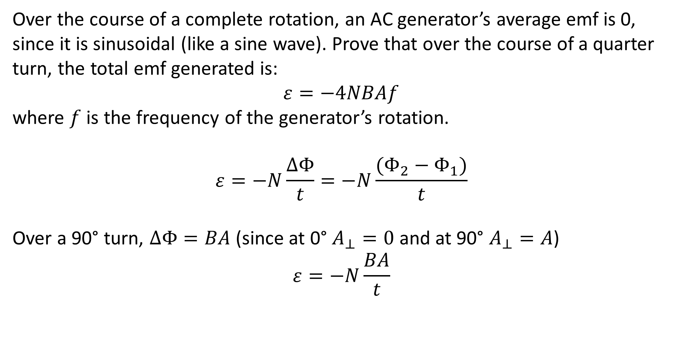
Example #1b
Over the course of a complete rotation, an AC generator’s average emf is 0, since it is sinusoidal (like a sine wave). Prove that over the course of a quarter turn, the total emf generated is:
$$ε=−4NBAf$$
where $f$ is the frequency of the generator’s rotation.
$$ε=−N\frac{ΔΦ}{t}=−N\frac{(Φ_{2}−Φ_{1})}{t}$$
Over a 90° turn, $ΔΦ=BA$ (since at 0° $A_{⊥}=0$ and at 90° $A_{⊥}=A$)
$$ε=−N\frac{BA}{t}$$

Slide 9
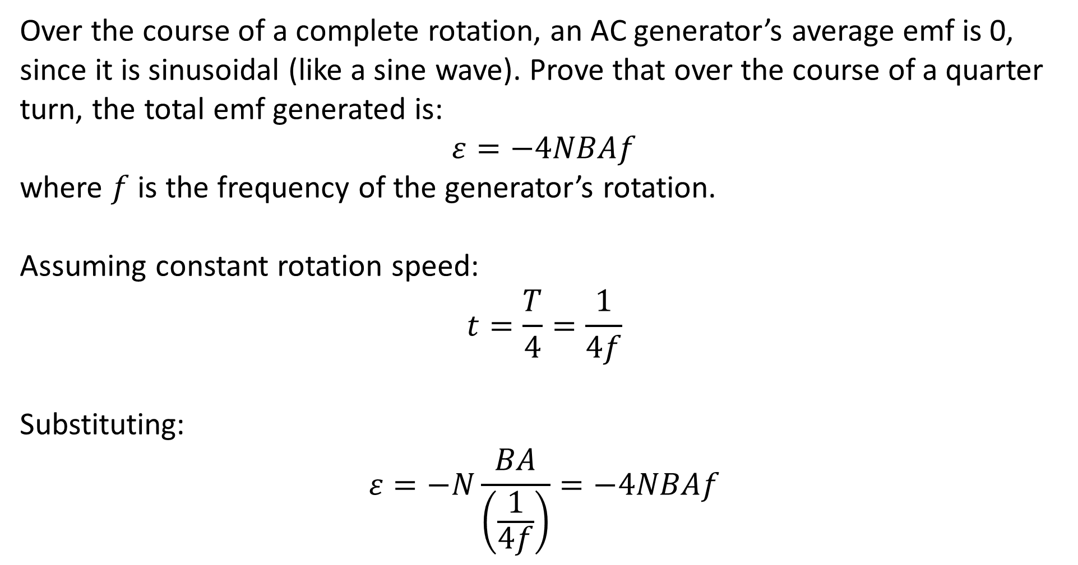
Example #1b
Over the course of a complete rotation, an AC generator’s average emf is 0, since it is sinusoidal (like a sine wave). Prove that over the course of a quarter turn, the total emf generated is:
$$ε=−4NBAf$$
where $f$ is the frequency of the generator’s rotation.
Assuming constant rotation speed:
$$t=\frac{T}{4}=\frac{1}{4f}$$
Substituting:
$$ε=−N\frac{BA}{\left(\frac{1}{4f}\right)}=−4NBAf$$

Slide 10
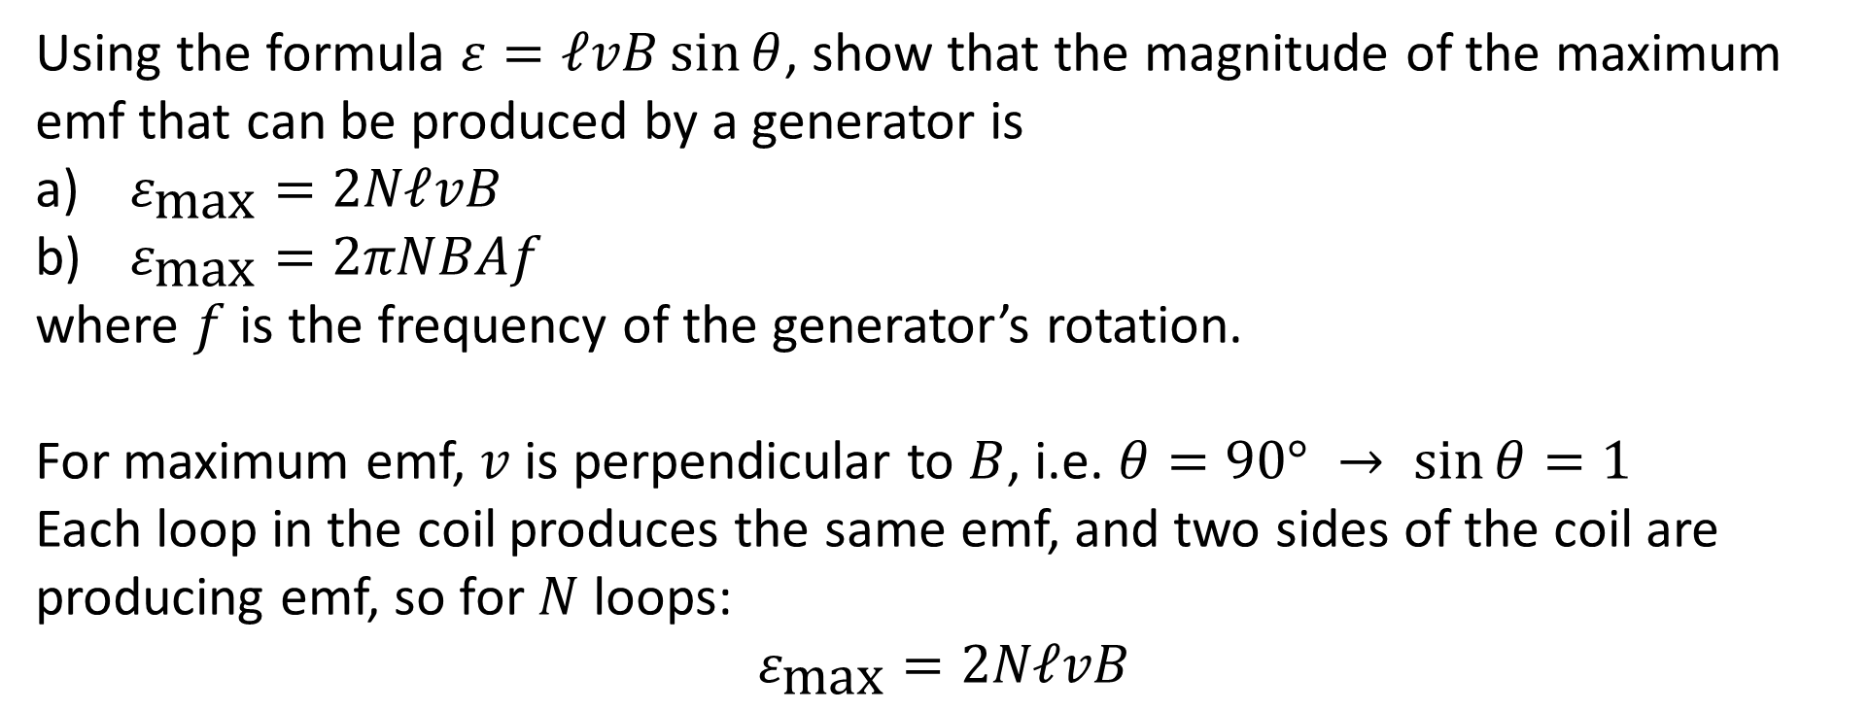
Example #2
Using the formula $ε=ℓvB\sin{θ}$, show that the magnitude of the maximum emf that can be produced by a generator is
$ε_{\text{max}}=2NℓvB$
$ε_{\text{max}}=2πNBAf$
where $f$ is the frequency of the generator’s rotation.
For maximum emf, $v$ is perpendicular to $B$, i.e. $θ=90° → \sin{θ}=1$
Each loop in the coil produces the same emf, and two sides of the coil are producing emf, so for $N$ loops:
$$ε_{\text{max}}=2NℓvB$$

Slide 11
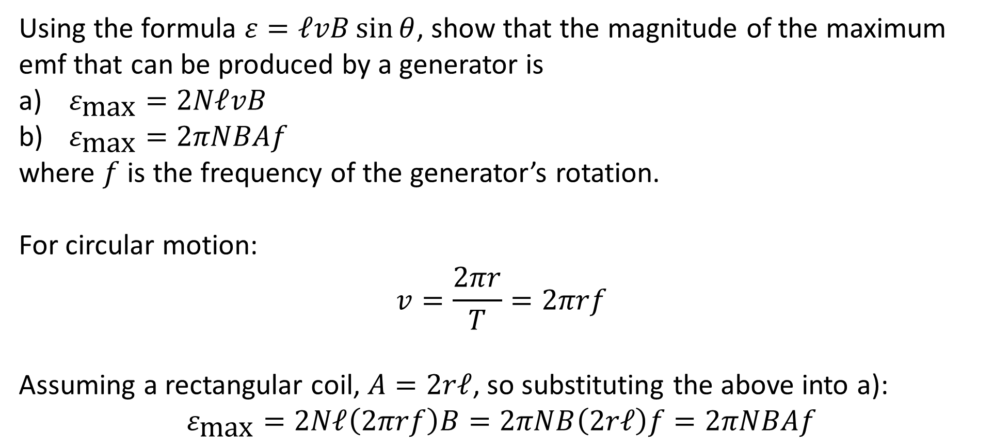
Example #2
Using the formula $ε=ℓvB\sin{θ}$, show that the magnitude of the maximum emf that can be produced by a generator is
$ε_{\text{max}}=2NℓvB$
$ε_{\text{max}}=2πNBAf$
where $f$ is the frequency of the generator’s rotation.
For circular motion:
$$v=\frac{2πr}{T}=2πrf$$
Assuming a rectangular coil, $A=2rℓ$, so substituting the above into a):
$$ε_{\text{max}}=2Nℓ\left(2πrf\right)B=2πNB\left(2rℓ\right)f=2πNBAf$$

Slide 12
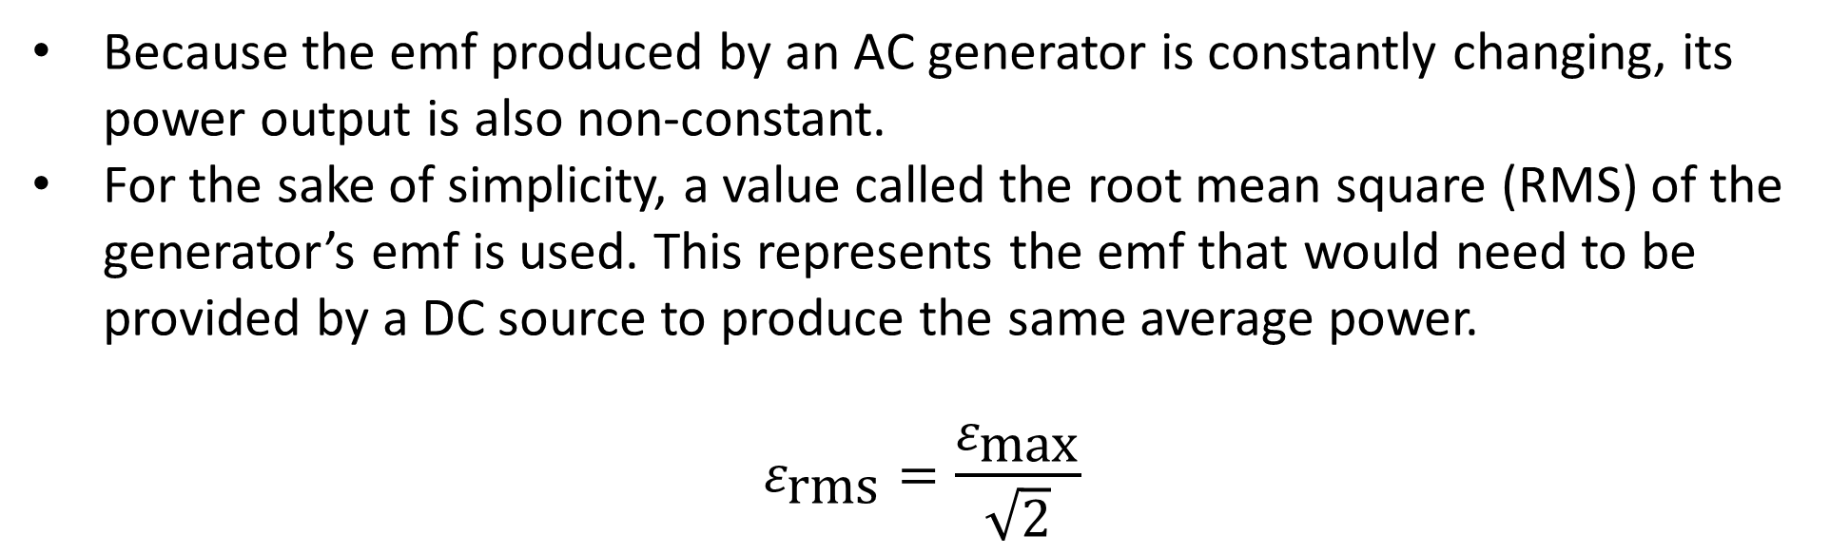
RMS of emf
Because the emf produced by an AC generator is constantly changing, its power output is also non-constant.
For the sake of simplicity, a value called the root mean square (RMS) of the generator’s emf is used. This represents the emf that would need to be provided by a DC source to produce the same average power.
$$ε_{\text{rms}}=\frac{ε_{\text{max}}}{\sqrt{2}}$$

